Slide 1

Computer Graphics
Dr. Lucy J. Gudino
Computer Science & Information Systems Group
Birla Institute of Technology & Science, Pilani, Goa Campus

Slide 2
The Midpoint Line Algorithm
Given : (x₀, y₀) and (x₁, y₁)
Let x = x₀ ; y = y₀;
dy = y₁ – y₀; dx = x₁ – x₀;
d = 2dy – dx ;
(Δd)_{E} = 2dy ;
(Δ d)_{NE} = 2(dy - dx) ;
Plot_Point(x,y)

Slide 3
The Midpoint Line Algorithm……
while (x < x₁)
    if (d <= 0) /* Choose E */
      d = d + (Δd)_{E} ;
    else /* Choose NE */
      d = d + (Δ d)_{NE};
      y = y + 1
    endif
    x = x + 1 ;
    Plot_Point(x, y) ;
end while

Slide 4
Example
Starting Point: (4, 8)
Ending Point : (9,12)

Slide 5
Advantages
Based on incremental method –
no round off function
only integer arithmetic

Slide 6
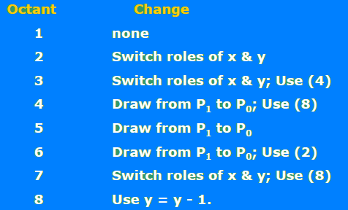
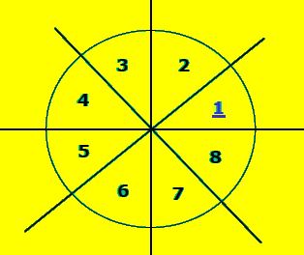
Contd……

Slide 7
Contd……
Draw from P1 to P0:
    swap(P0, P1).
    Use y = y - 1; dy = -dy;
Switch Roles of X & Y:
    Swap (x1, y1);
    Swap (x0, y0 );
    Swap (dx, dy);
    plot_point(y, x);

Slide 8
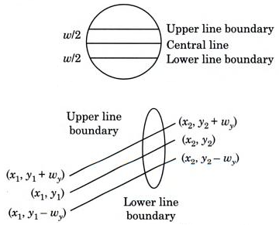
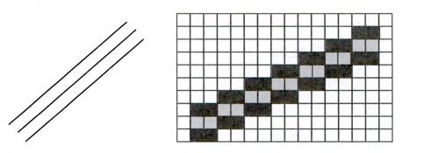
Thick Lines
Line drawing algorithms generate lines with thickness 1 pixel
to draw line with any width w ➔ draw a vertical span of w/2 pixels on both the sides of the central line

Slide 9
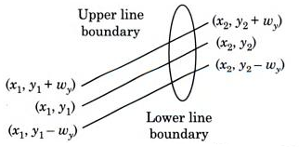

Contd…
upper line boundaries are :
(x₁, y₁+w_{y})(x₂, y₂+w_{y})
lower line boundaries are:
  (x₁, y₁-w_{y})(x₂, y₂-w_{y})
where

Slide 10

Contd…
Why (w-1) instead of w?
If slope is greater than 1, roles of x and y are interchanged
Implement an algorithm to draw thick line
Notes:
Line boundaries are drawn which are of 1 pixel in length. Therefore, from both the sides half of the pixel width will be deducted to get the exact width w.

Slide 11

Aliasing
Bit map for drawing images
Zaggy boundaries – error in line segment
Aliasing is dominant for lines having slopes less than 20⁰ or grater than 70⁰
More prominent
  low resolution display
  high contrast
Antialiasing : process of removing aliasing effect

Slide 12
Aliasing
Methods of Antialiasing
  Increasing Resolution
  Unweighted Area Sampling
  Weighted Area Sampling

Slide 13
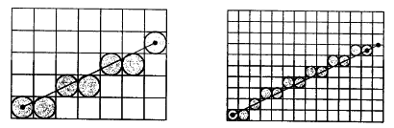
Increasing the resolution
Drawback: Need a huge frame buffer

Slide 14
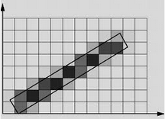
Unweighted Area Sampling
Line drawing algorithm chooses the pixel which is closer to the true line
Modification is needed
  Find pixel intensity by calculating the areas of overlap of each pixel within the objects to be displayed
  Intensity of the pixel is proportional to the amount of the line area occupied by the pixel

Slide 15
Weighted Area Sampling
Weighted Area Sampling
  the intensity of the pixel is dependent on the line area occupied and the distance of the area from the pixel’s center.
  Define a weighting function that determines the influence on the intensity of the pixel.

Slide 16


Some points worth considering
Intensity of a line depending on the slope
  It can be noted that lines with slopes near to ±1 appear to be fainter than those with slopes near to 0 or ∞.
  This discrepancy can be solved by varying the intensity of the pixels according to the slope.

Slide 17
Some points worth considering
Endpoint Order
  It must be ensured that a line drawn from (x0 , y0) to (x1,y1) must be identical to the line drawn from (x1 ,y1) to (x0;,y0).
  In the midpoint algorithm, the point E is chosen when d = 0. (i.e. when the line passes through the midpoint of NE and E.) Thus it must be ensured that when the line is plotted from right to left, the point SW (not W) is selected when the criterion does not specify an obvious choice.

Slide 18
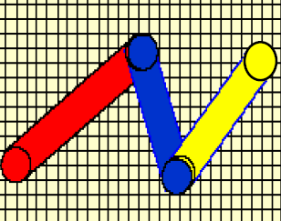
Some points worth considering
Drawing Polylines
  While drawing polylines, it must be ensured that the shared vertices are plotted only once.

Slide 19
Circle Drawing

Slide 20

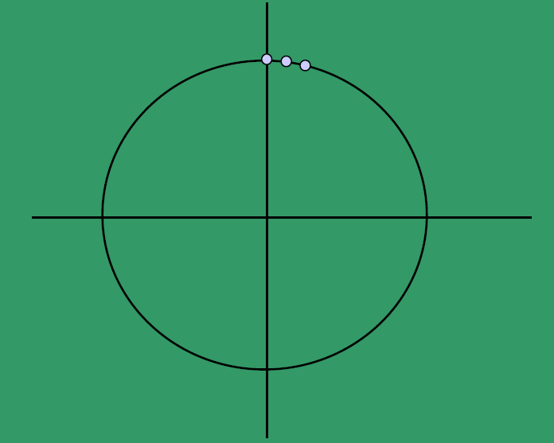
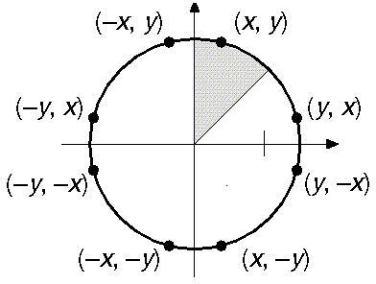
Introduction
Circle is represented as
divide in 8 octants
What is special about 8-fold symmetry?

Slide 21
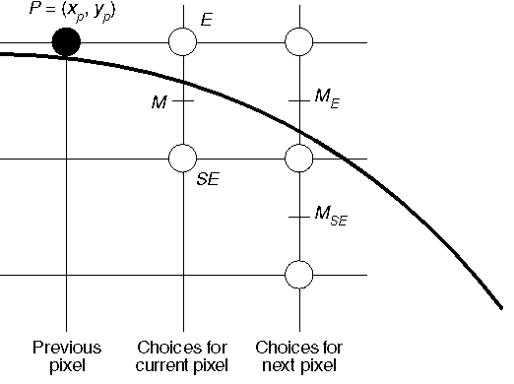
Contd...
Midpoint Circle Algorithm
  trace out arc in 2nd octant and draw the rest by symmetry
  choose between E and SE pixel at each stage

Slide 22
Contd…
Only considers circles centered at the origin with integer radii.
Can apply translations to get non-origin centered circles.
Explicit equation : y = +/- sqrt(R² - x²)
Implicit equation: F(x,y)= x² + y² - R² =0
Note: Implicit equations used extensively for advanced modeling

Slide 23
Contd…
Use of Symmetry: Only need to calculate one octant. One can get points in the other 7 octants as follows:
  Draw_circle(x, y)
  begin
    Plotpoint (x, y); Plotpoint (y, x);
    Plotpoint (x, -y); Plotpoint (-y, x);
    Plotpoint (-x, -y) ; Plotpoint (-y, -x);
    Plotpoint (-x, y); Plotpoint (y,- x);
  end

Slide 24
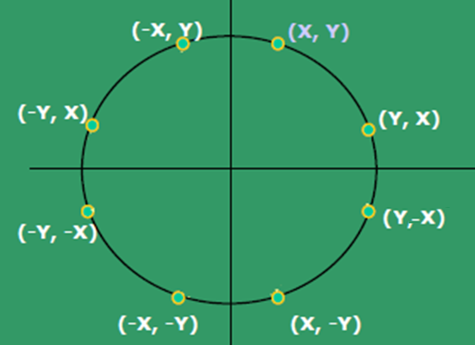
Contd…

Slide 25
Step 1: Calculate points for second octant
Step 2:Use draw_circle procedure to calculate remaining points in other octants
Choice : E or SE
  F(x, y) = x² + y² - R² =0
  F(x, y) > 0 if mid point is outside the circle
  F(x, y) < 0 if mid point inside the circle.
  Again, use d_{old} = F(M) ;
  F(M) = F(X_{p} + 1, Y_{p}- 1/2)
  = (X_{p} + 1)² + (Y_{p} - 1/2)² - R²

Slide 26
Contd…
d >= 0 choose SE ; next midpoint: M_{new};
x = x+1 , y = y-1 which gives d_{new}.
d < 0 choose E ; next midpoint: M_{new};
x = x+1 which gives d_{new}.

Slide 27
Contd…
(Δd)_{SE} = d_{new} – d_{old}
        = F(Xp + 2, Yp - 3/2) - F(Xp + 1, Yp- 1/2)
        = 2Xp – 2Yp + 5 ;
(Δd)_{E} = d_{new} – d_{old}
        =F(Xp + 2, Yp - 1/2) - F(Xp + 1, Yp- 1/2)
        = 2Xp + 3;
dstart = F(X₀ + 1, Y₀ - 1/2) = F(1, R - 1/2)
        = 1 + (R - 1/2)² - R² = 1 + R² - R + 1/4 - R²
        = 5/4 - R
To avoid fraction,
Let h = d_{start} -¼ => h_{start} = 1 - R
Comparison is: h < -1/4.
Since h is initialized to and incremented by integers, so we can just do with: h < 0.

Slide 28
The Midpoint Circle algorithm 1
x = 0; y = R;
h = 1 – R;
draw_circle(x, y);
while (y > x)
  if (h < 0) /* select E */
    h = h + 2x + 3;
else /* select SE */
h = h + 2(x - y) + 5;
y = y - 1;
endif
x = x + 1;
draw_circle(x, y);
End_while

Slide 29
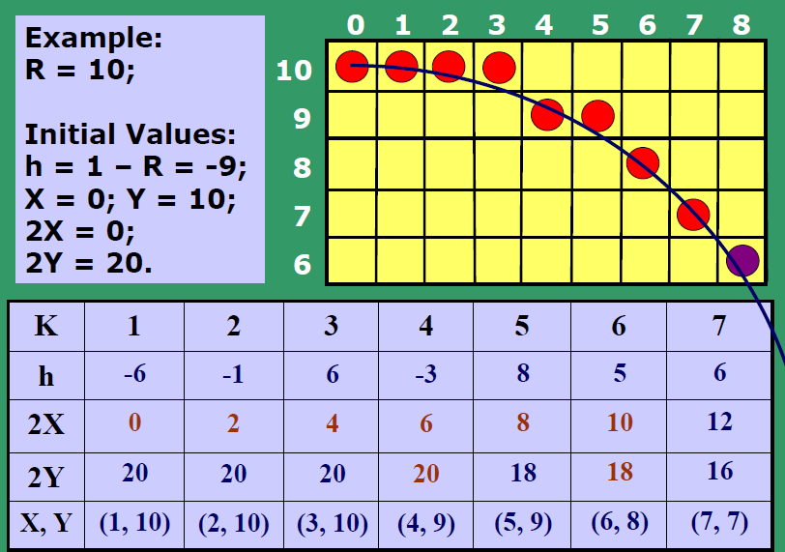
Example

